Slide 1
Submission for Game of Threads Challenge Dump Analyzer
Udit Agarwal
Software Engineer, IDC - Noida
1st June 2018

Slide 2
Debugging Uses cases
Lower level firmware
(e.g BootROM)
Only debugger can be used for debugging.
Middle Level firmware
(e.g. U-Boot)
Issue while uboot is running can only be debugged using debugger
U-boot Prompt
If any debugging needs to be done, either debugger or u-boot console to be used
Kernel
Issue while kernel is booting can only be debugged using debugger
Kernel Prompt
Kernel console or debugger can be used for debugging.

Slide 3
Dump Analyzer…
Features
Ease of Use
Caters all uses cases
Text and XML based output.
Web interface analysis
Considers endianness & address alignment.
Less number of user inputs.

Slide 4
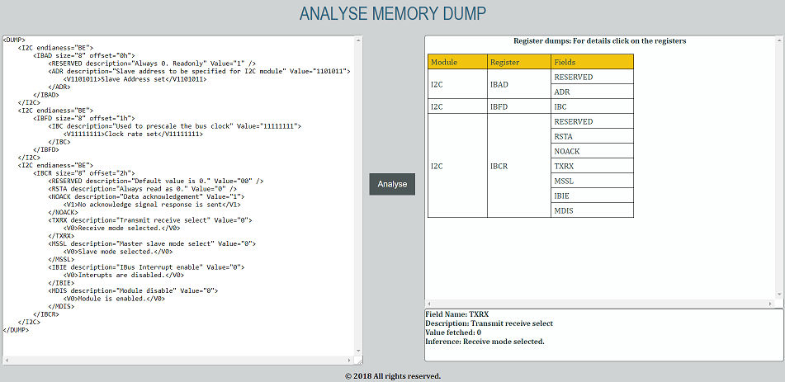



Dump Analyzer…
User Input file
Memory dump
For debugger mode only
Dump Analyzer
What tool provides…
1. For kernel debugging data is fetched by tool itself.
2. For debugger interface, tool creates the CCS/U-Boot scripts based on the input file that helps user in taking dump.
3. Text or XML based output also client side web interface to analyze the XML.

